Slide 1

National Research University Higher School of Economics Faculty of Computer Science
Master’s Programme ‘System and Software Engineering’
OPTICAL FLOW ESTIMATION BASED ON DEEP LEARNING APPROACHES
Student: Attakorah Joseph Afriyie
Supervisor: Professor Hadi Saleh
Moscow, 2019

Slide 2

Faculty of Computer Science / Master’s Programme ‘System and Software Engineering’
INTRODUCTION
Images have special characteristics;
Videos have specific temporal resolution characteristics i.e. frame per second (fps);
Optical Flow is the pattern of apparent motion of an object in a visual scene caused by the relative motion between an observer and the scene;
Computer Vision technique.

Slide 3
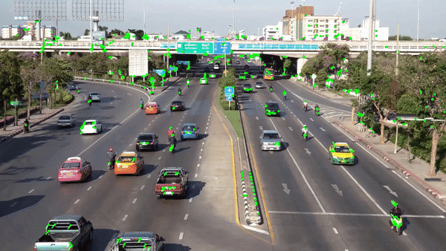
Faculty of Computer Science / Master’s Programme ‘System and Software Engineering’
Description of Subject AREA
Scene
Figure 1, [8]

Slide 4
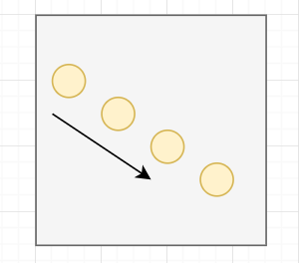
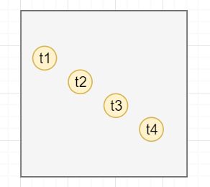
Optical Flow
An object moves from the top left to bottom right

Slide 5
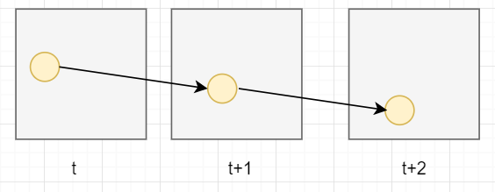
Optical Flow: Video frames

Slide 6
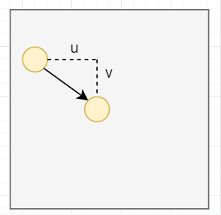
Optical Flow Estimation Problem
How do we estimate the displacement?

Slide 7
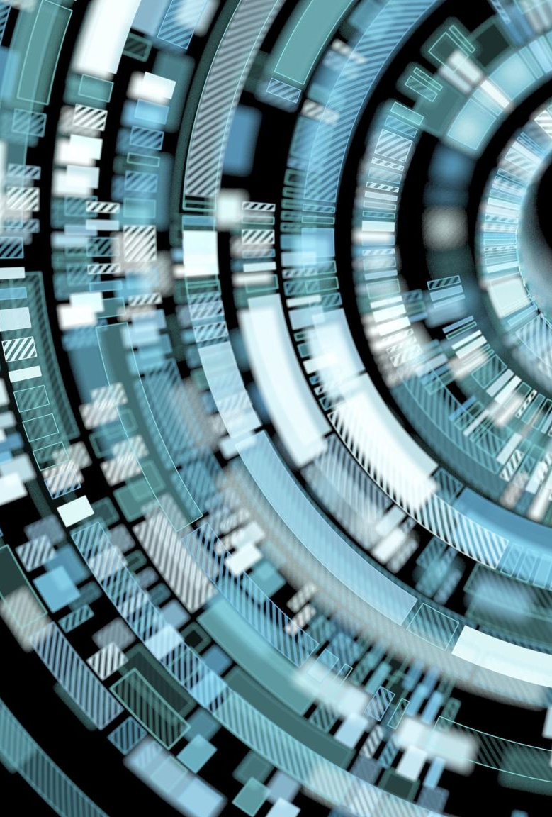
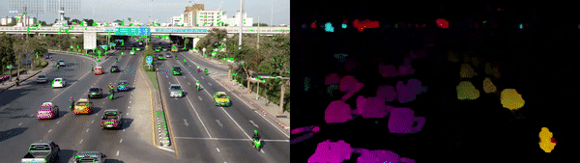
Sparse vs dense Optical Flow
Figure 2,[8]
Sparse techniques only need to process some pixels from the whole image
Dense techniques process all the pixels

Slide 8
Optical Flow Estimation Problem
- The problem of optical flow has historically been an optimization problem in computer vision
- Recent approaches by applying deep learning have shown impressive results.
Relevance and Use
Motion detection, video compression, Motion estimation and video compression have developed as a major aspect of optical flow research

Slide 9
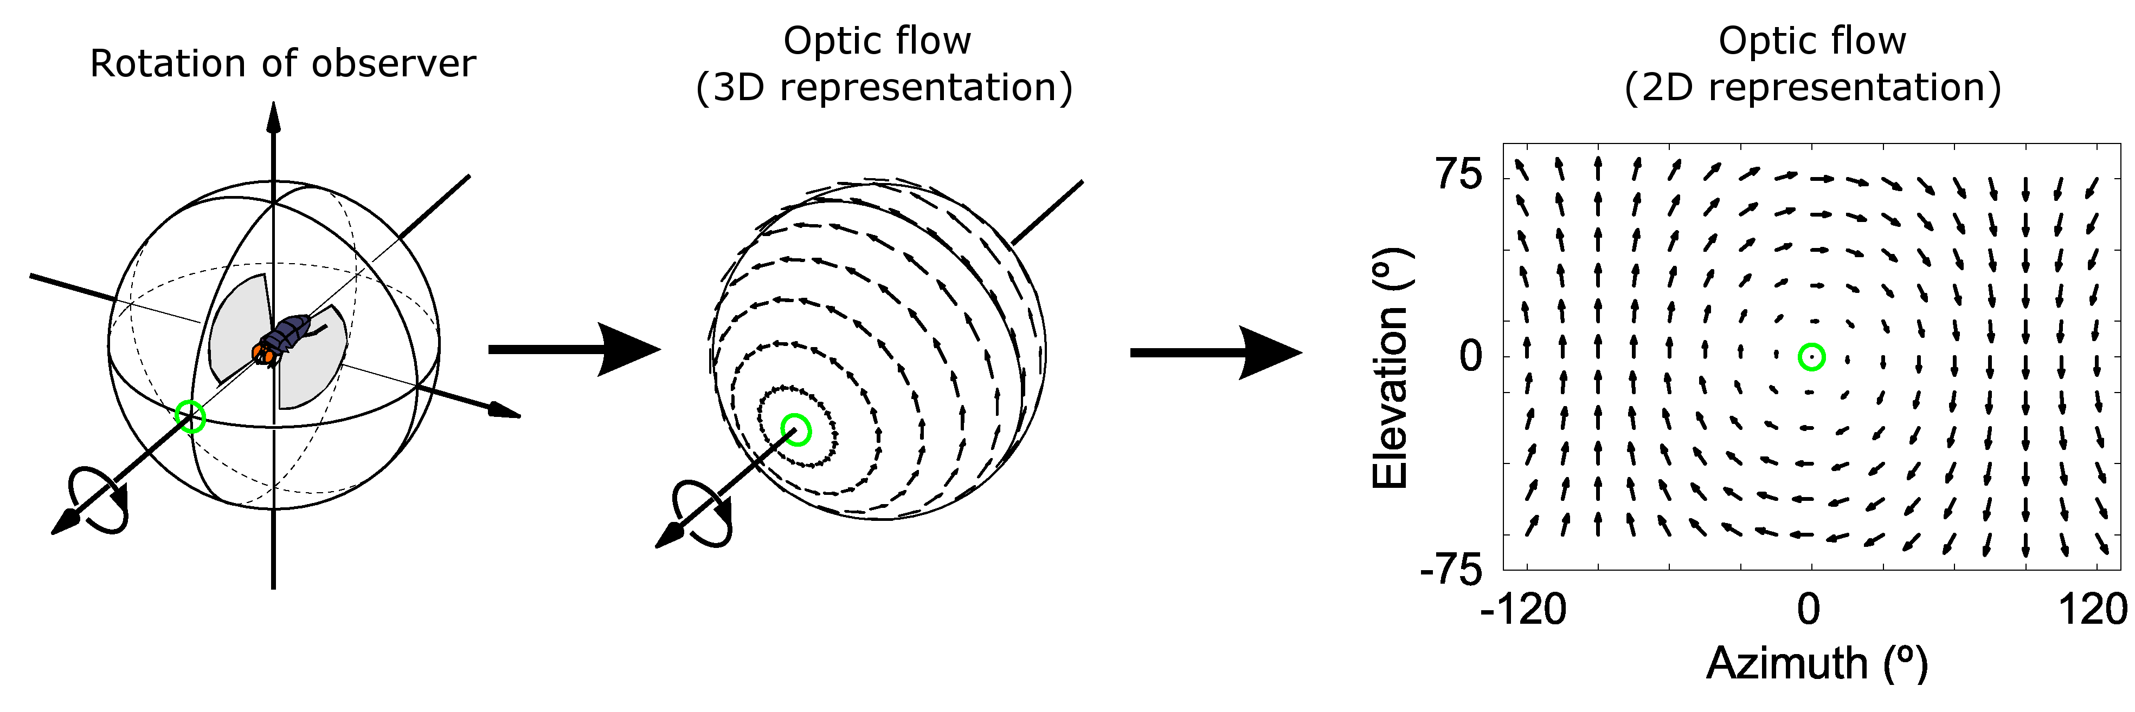
Optical Flow – State of the art - previous
The concept of optical flow was introduced by the American psychologist James J. Gibson in the 1940s to describe the visual stimulus provided to animals moving through the world. Gibson stressed the importance of optic flow for affordance perception, the ability to discern possibilities for action within the environment.
The optic flow experienced by a rotating observer (in this case a fly). The direction and magnitude of optic flow at each location is represented by the direction and length of each arrow.

Slide 10
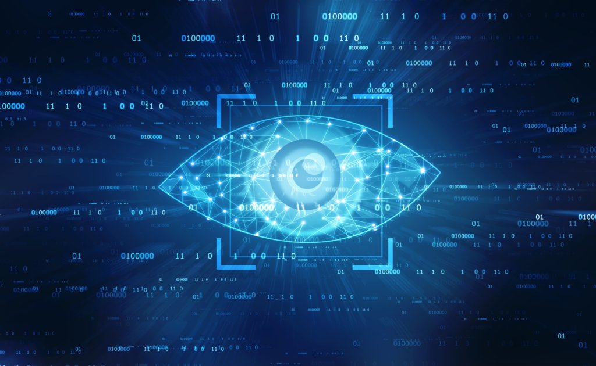
Optical Flow – State of the art - previous
As a goal to determine how computers can be made to gain high-level understanding from digital images or videos and to automate tasks that the human visual system can do, optical flow became a computer vision technique with pioneering researchers Horn and Schunck
ESTIMATION: Sequences of ordered images allow the estimation of motion as either instantaneous image velocities or discrete image displacements. The optical flow methods try to calculate the motion between two image frames which are taken at successive frame times at every voxel position.
Computer Vision [9]

Slide 11
Optical Flow – State of the art – previous Methods
• Phase correlation – inverse of normalized cross-power spectrum
• Block-based methods – minimizing sum of squared differences or sum of absolute differences, or maximizing normalized cross-correlation
• Differential methods of estimating optical flow, based on partial derivatives of the image signal and/or the sought flow field and higher-order partial derivatives, such as:
O Lucas–Kanade method – regarding image patches and an affine model for the flow field
o Horn–Schunck method – optimizing a functional based on residuals from the brightness constancy constraint, and a particular regularization term expressing the expected smoothness of the flow field
• Discrete optimization methods – the search space is quantized, and then image matching is addressed through label assignment at every pixel, such that the corresponding deformation minimizes the distance between the source and the target image. The optimal solution is often recovered through Max-flow min-cut theorem algorithms, linear programming or belief propagation methods.

Slide 12
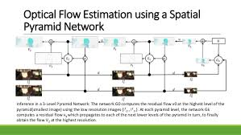
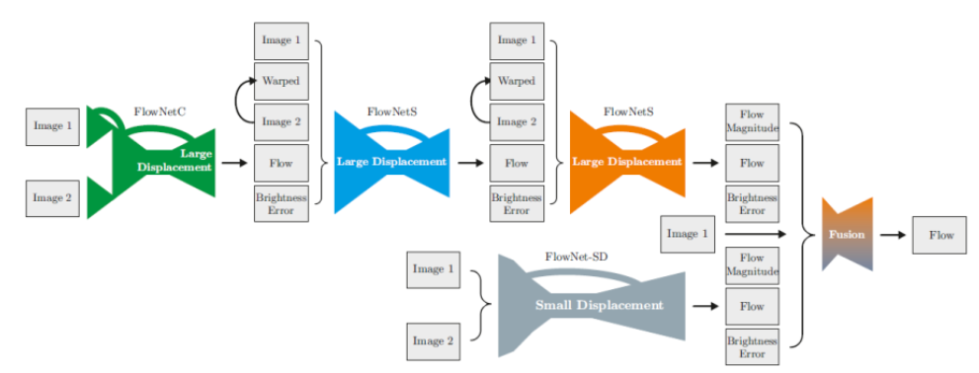
Optical Flow – State of the art - Current
SpyNet FlowNet2
The reported results by FlowNet2 and SpyNet show a clear trade-off between accuracy and model size

Slide 13
Deep learning Approaches
The problem of optical flow has since/historically been an optimization problem in computer vision. Motivation: Since optical flow is used in motion detection, video compression and several safety-critical applications like self-driving cars, it is important to optimize it to the best of its performance with state-of-the-art.
Deep learning techniques has shown impressive results. Compared with traditional methods, CNN achieved a large improvement in quality in estimating optical flow.

Slide 14
State of the art
Traditional Methods
Technology | Year | Advantages | Limitations
Determining optical flow. Artificial intelligence, Horn, B. K., & Schunck | 1981 | yields a high density of flow vectors, i.e. the flow information missing in inner parts of homogeneous objects is filled in from the motion boundaries | complex and computationally expensive in real-time applications. It is more sensitive to noise than local methods
Lucas Kanade method regarding image patches and an affine model for the flow field | 1981 | very fast calculation and accurate time derivatives | Manually tune all parameters, hence low scalability and errors on boundaries of moving object

Slide 15
State of the art
Traditional Methods
Technology | Year | Advantages | Limitations
FlowNetCorr | 2015 | Faster rendering speed than traditional computer vision methods | Two images are convoluted separately and are combined by a correlation layer. Poor performance on displacement
Flownet: Learning optical flow with convolutional networks. (FlowNetS) | 2015 | Faster rendering speed than traditional computer vision methods | simply stacks two sequentially adjacent images as input. Produces noisy and blurred results
FlowNet 2.0: Evolution of Optical Flow Estimation with Deep Networks | 2016 | stacked by flownets and flownetcorr, and produces much better results. Based on FlowNet | FlowNet 2.0 is only marginally slower than the original FlowNet although decreases the estimation error by more than 50%
Optical Flow Estimation using a Spatial Pyramid Network (Spynet) | 2016 | much more lightweight, with fewer parameters, faster, and produces large motions in a course to fine manner | performs below FlowNet2.0

Slide 16
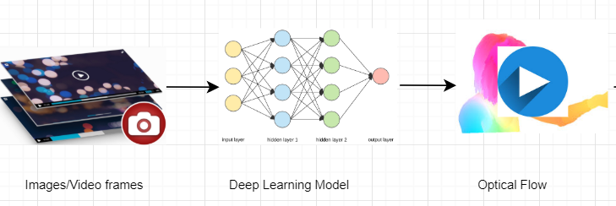
Faculty of Computer Science / Master’s Programme ‘System and Software Engineering’
Proposed approach

Slide 17
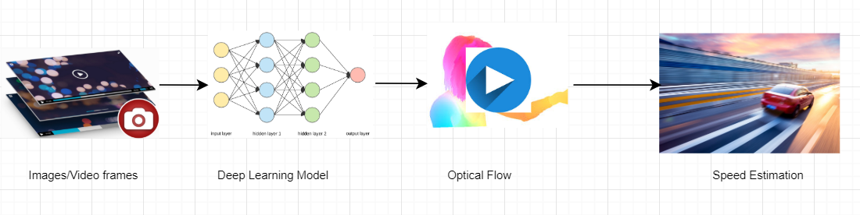
Faculty of Computer Science / Master’s Programme ‘System and Software Engineering’
Proposed approach

Slide 18
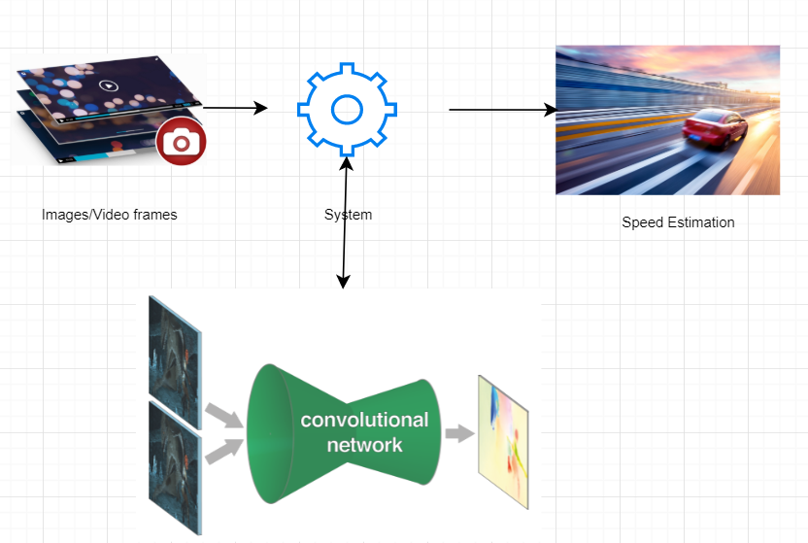
Faculty of Computer Science / Master’s Programme ‘System and Software Engineering’
Proposed approach

Slide 19





Faculty of Computer Science / Master’s Programme ‘System and Software Engineering’
Tools and technologies

Slide 20
Faculty of Computer Science / Master’s Programme ‘System and Software Engineering’
Related works
Non-Deep Learning (DL) Method
Title: Determining optical flow. Artificial intelligence, Horn, B. K., & Schunck
optimizing a functional based on residuals from the brightness constancy constraint, and a particular regularization term expressing the expected smoothness of the flow field [11]
Year: 1981
Limitation: complex and computationally expensive in real-time applications
Title: Lucas Kanade method
It assumes that the flow is essentially constant in a local neighbourhood of the pixel under consideration, and solves the basic optical flow equations for all the pixels in that neighbourhood, by the least squares criterion [10]
Year: 1981
Limitation: Manually tune all parameters, hence low scalability

Slide 21
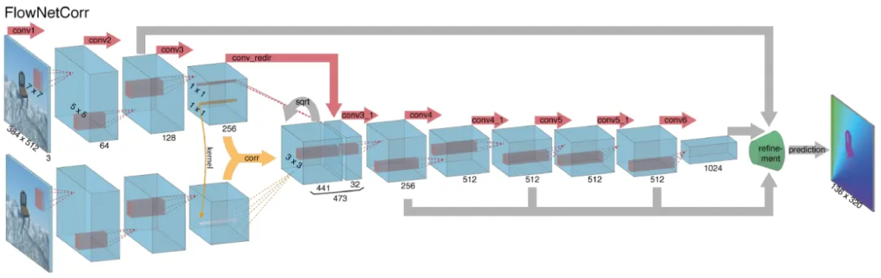
Faculty of Computer Science / Master’s Programme ‘System and Software Engineering’
Related works
Deep Learning (DL) Method
Title:FlowNetCorr
Year: 2015
Advantages: Faster rendering speed than traditional computer vision methods
Limitation: Two images are convoluted separately and are combined by a correlation layer. Poor performance on displacement

Slide 22
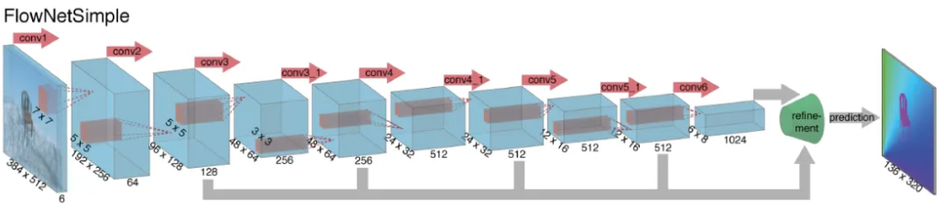
Faculty of Computer Science / Master’s Programme ‘System and Software Engineering’
Related works
Deep Learning (DL) Method
Title: Flownet: Learning optical flow with convolutional networks. (FlowNetS)
Year: 2015
Advantages: Faster rendering speed than traditional computer vision methods
Limitation: simply stacks two sequentially adjacent images as input. Produces noisy and blurred results.

Slide 23
Faculty of Computer Science / Master’s Programme ‘System and Software Engineering’
Related works
Deep Learning (DL) Method
Title: FlowNet 2.0: Evolution of Optical Flow Estimation with Deep Networks
Year: 2016
Advantages: stacked by flownets and flownetcorr, and produces much better results. Based on FlowNet
Limitation: FlowNet 2.0 is only marginally slower than the original FlowNet although decreases the estimation error by more than 50%

Slide 24
Faculty of Computer Science / Master’s Programme ‘System and Software Engineering’
Related works
Deep Learning (DL) Method
Title: Optical Flow Estimation using a Spatial Pyramid Network (Spynet)
Year: 2016
Advantages: much more lightweight, with fewer parameters, faster, and produces large motions in a course to fine manner
Limitation: performs below FlowNet2.0

Slide 25
Faculty of Computer Science / Master’s Programme ‘System and Software Engineering’
Objective
To generate a model which would be able to produce effective optical flow for given input sequence of raw images.
Tasks
Review related works on optical flow; 3 weeks
Understand the dataset which contains images for training; 1 week
Use deep learning approaches and TensorFlow library to generate a model; 1 Month
Test the accuracy by comparing the produced optical flow with ground truth. 1 Month

Slide 26
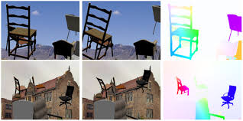
Faculty of Computer Science / Master’s Programme ‘System and Software Engineering’
Methods and Algorithms And Technologies
FlowNet2.0
FlowNetS
FlowNetC
PWC-Net
Popular data sets: FlyingThings3D and KITTI optical flow 2015
Technologies: TensorFlow library and deep learning techniques

Slide 27
Faculty of Computer Science / Master’s Programme ‘System and Software Engineering’
Expected Results And evaluation
Optical Flow Estimation Model (Deep learning model):
- The estimated approach should be able to generate a per-pixel
prediction with images;
- The expected solution would be compared and evaluated with other solutions based on Deep Learning approaches.

Slide 28
Faculty of Computer Science / Master’s Programme ‘System and Software Engineering’
Reference
[1] Ilg, E., Mayer, N., Saikia, T., Keuper, M., Dosovitskiy, A., & Brox, T. (2017). Flownet 2.0: Evolution of optical flow estimation with deep networks. In Proceedings of the IEEE conference on computer vision and pattern recognition (pp. 2462-2470).
[2] Dosovitskiy, A., Fischer, P., Ilg, E., Hausser, P., Hazirbas, C., Golkov, V., ... & Brox, T. (2015). Flownet: Learning optical flow with convolutional networks. In Proceedings of the IEEE international conference on computer vision (pp. 2758-2766).
[3] Sun, D., Yang, X., Liu, M. Y., & Kautz, J. (2018). PWC-Net: CNNs for optical flow using pyramid, warping, and cost volume. In Proceedings of the IEEE Conference on ComputerVision and Pattern Recognition (pp. 8934-8943).
[4] Menze, M., & Geiger, A. (2015). Object scene flow for autonomous vehicles. In Proceedings of the IEEE
[5] Conference on Computer Vision and Pattern Recognition (pp. 3061-3070).
[6] B.D. Lucas, T. Kanade, ”An Image Registration Technique with an Application to Stereo Vision”, in Proceedings of Image Understanding Workshop, 1981, pp. 121-130
[7] Gituma, Mark. “What Is Optical Flow and Why Does It Matter in Deep Learning.” Medium, The Startup, 23 June 2019, https://medium.com/swlh/what-is-optical-flow-and-why-does-it-matter-in-deep-learning-b3278bb205b5
[8] https://nanonets.com/blog/optical-flow/
[9] https://skywell.software/blog/top-6-computer-vision-techniques-and-algorithms/
[11] B. D. Lucas and T. Kanade (1981), An iterative image registration technique with an application to stereo vision. Proceedings of Imaging Understanding Workshop, pages 121—130
[12] B.K.P. Horn and B.G. Schunck, "Determining optical flow." Artificial Intelligence, vol 17, pp 185–203, 1981. Manuscript available on MIT server

Slide 29
Thank You for attention
Thanks to Shadi Saleh from Germany
Address: 20 Myasnitskaya Ulitsa, Moscow 101000 Russia | 11 Pokrovsky Boulevard, Moscow 109028 Russia

